Slide 1



Slide 2

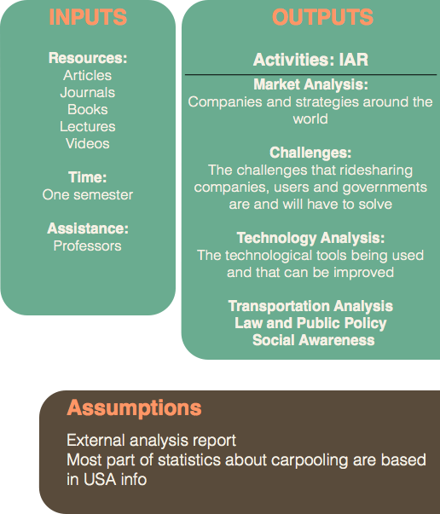
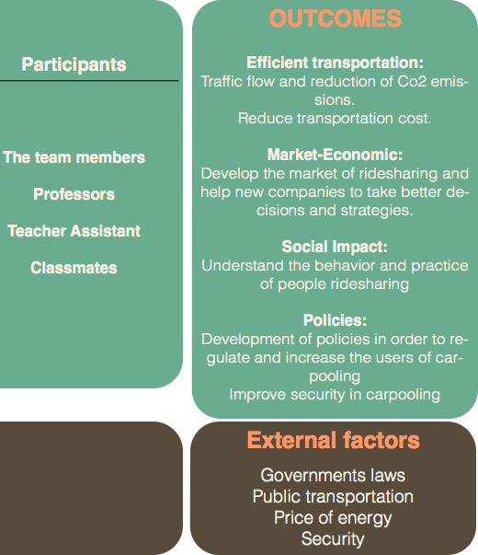
LOGIC MODEL

Slide 3
MOTIVATIONS
2010
More than 1 000 000 000 vehicles
in the world
2014
87 000 000 vehicles produced
in the world

Slide 4
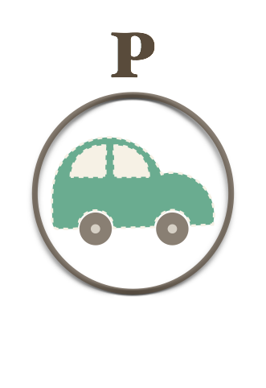
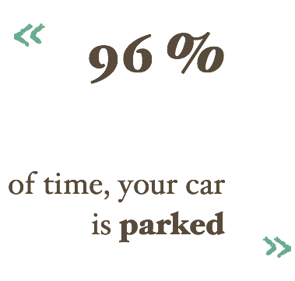
MOTIVATIONS
MOTIVATIONS
It highlights a crucial inefficiency of mass private car ownership.
Sources:
OICA 2014 Statistics
Journal Wards Auto
International Parking Institute

Slide 5
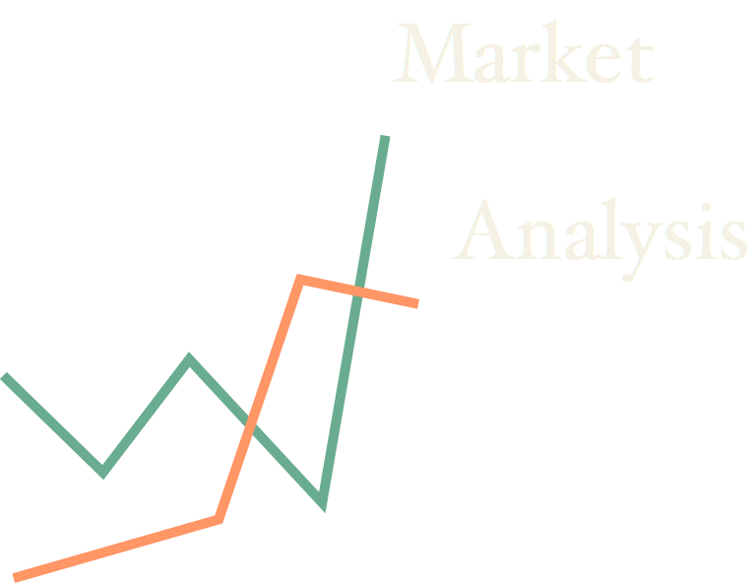

Slide 6
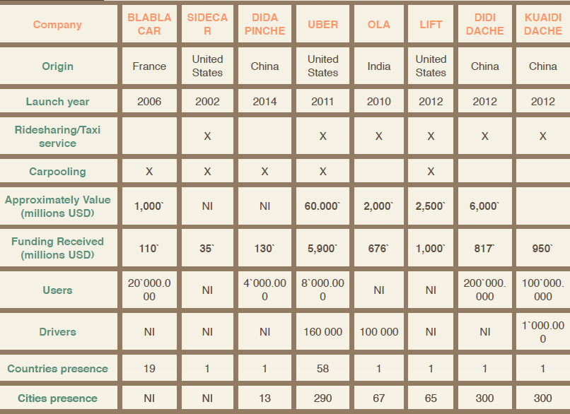
Market Analysis
MOTIVATIONS
Everyone is working with each other and
working against each other.
Sources: crunchbase.com

Slide 7
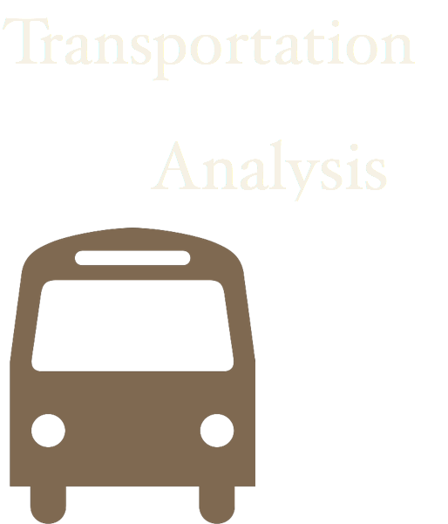


Slide 8
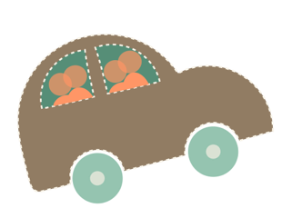

Transportation Analysis
MOTIVATIONS
62% of the cars
38% of the cars
6,2 L/100km
7,5 L/100km
15477 km/Year
8225 km/Year
Annual cost 1002€
1,39€/L
Increasing occupation rate to 2 person per car, will save
1,60€/L
400€
-12% of CO2 from transportation
&

Slide 9




Slide 10




Technologies Analysis
MOTIVATIONS
Blabla Car
Lyft
SideCat
Static Carpooling
Easy to implement
Easy to manage
Not flexible
User has to plan in early
Propose
Consult
User 1
User 2
User 3

Slide 11
Technologies Analysis
MOTIVATIONS
User 5
User 4
Dynamic Carpooling
Total flexibility
Secured
Use advanced technology
Hard to implement
Hard to manage
Hard to optimize
User 3
User 1
User 2
Propose
Suggest

Slide 12




Slide 13

Law & Social Policy
MOTIVATIONS
French leader of long-distance carpooling
Uberpop is illegal and will be prohibited
According to press reports, many Uberpop drivers were arrested and face up of 3 years in prison and 45,000 € fine.
There is carpooling when the trip could, anyway, was carried by the driver « empthy ».
There is no carpool when a driver as a taxi or VTC, realizes a trip specifically to serve the needs of a passenger.

Slide 14


Law & Social Policy
MOTIVATIONS
Offer or provide paid transport of persons using an automobile, a person must be authorized by a taxi owner's permit.
Passengers contribute to compensate the driver to use the vehicle, such as the sharing of costs of gasoline.
“Private cars will never operate as commercial cars.” – Transport Minister of China
2014
Beijing legalizes Carpooling
Passengers can calculate the fee with reference to the taxi fee and divide it by the number of the passengers.
GOAL : ease traffic congestion and conserve energy

Slide 15

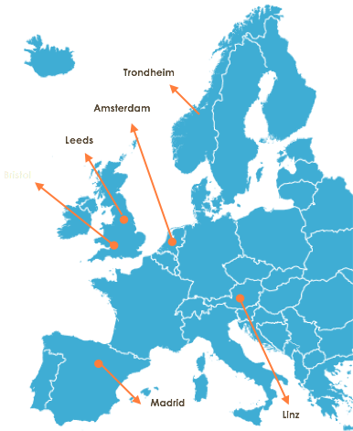
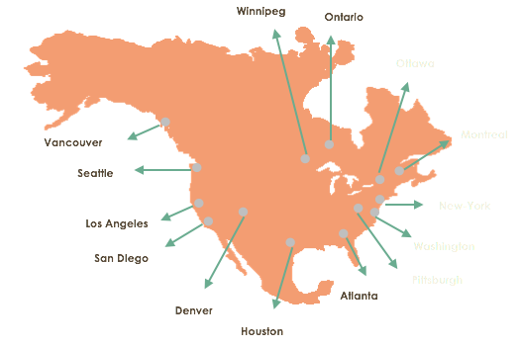
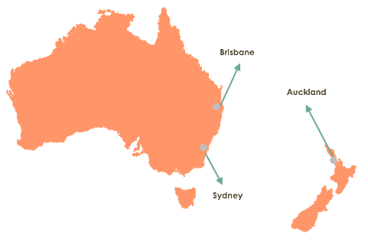
Law & Social Policy
MOTIVATIONS
Using carpool lanes typically saves
a minute per mile over driving alone

Slide 16



Slide 17




Social Awareness
MOTIVATIONS
Sharing vehicle expenses
Access to HOV lanes
Difficult to find someone with the same location & schedule
Prefer flexibility to drive alone
Need a vehicle during the day
Source : Who Chooses to Carpool and Why? Examination of Texas Carpoolers. Transportation Research Record, 2007

Slide 18
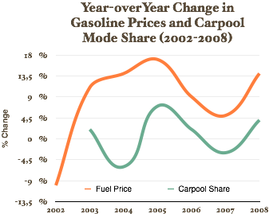
Social Awareness
MOTIVATIONS
Carpooling Declines
As Driving
Becomes Cheaper

Slide 19


Social Awareness
MOTIVATIONS
30 %
of users are
less than
35 years old

Slide 20
Conclusion
MOTIVATIONS
Social benefits will make ridesharing and carpooling companies will work together with government policies.
Intelligent algorithms for real time ridesharing will make more efficient. Reducing cost and environmental impact.
The future is the share economy.

Slide 21



Slide 22
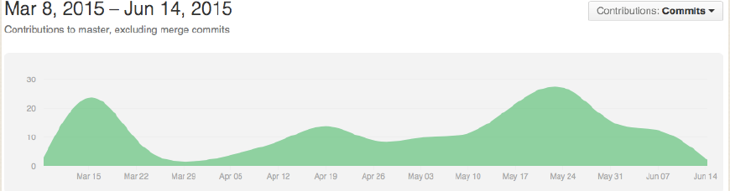
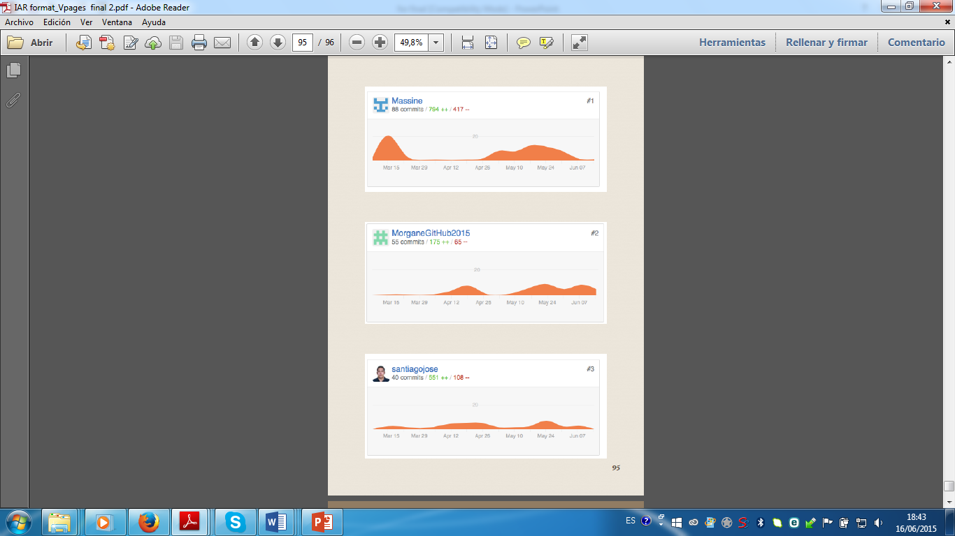

Slide 23


Thanks for your attention !

